Slide 1
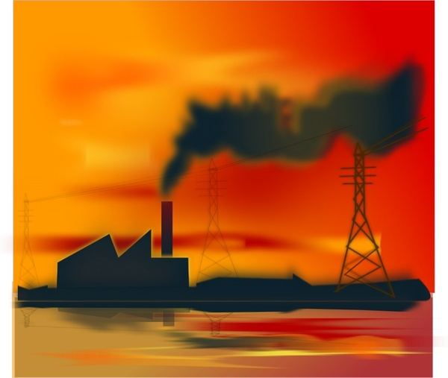
AIR POLLUTION
SUBJECT: ENVIRONMENTAL STUDIES
GRADE- 7

Slide 2
LAND ACKNOWLEDGEMENT
The campuses of Thompson Rivers University are located on the traditional and unceded territory of the Secwepemc Nation within Secwepemcul'ecw. As we share knowledge, teaching, learning and research within this university, we recognize that this territory has always been a place of teaching, learning and research. We respectfully acknowledge the Secwepemc—the peoples who have lived here for thousands of years, and who today are a Nation of 17 Bands. Take a moment to acknowledge the land you are currently living in!

Slide 3

THINK…!!!!
What do you understand by the term Pollution?
Select the things which causes pollution.
Vehicles smoke | Use of bicycles
wildfires | Fumes from spray cans
Person not smoking | Burning of fossil fuels
trees | Solar panels

Slide 4
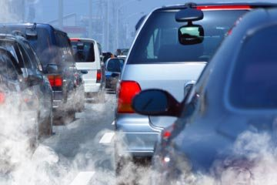
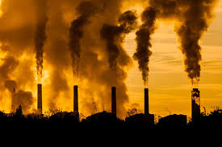
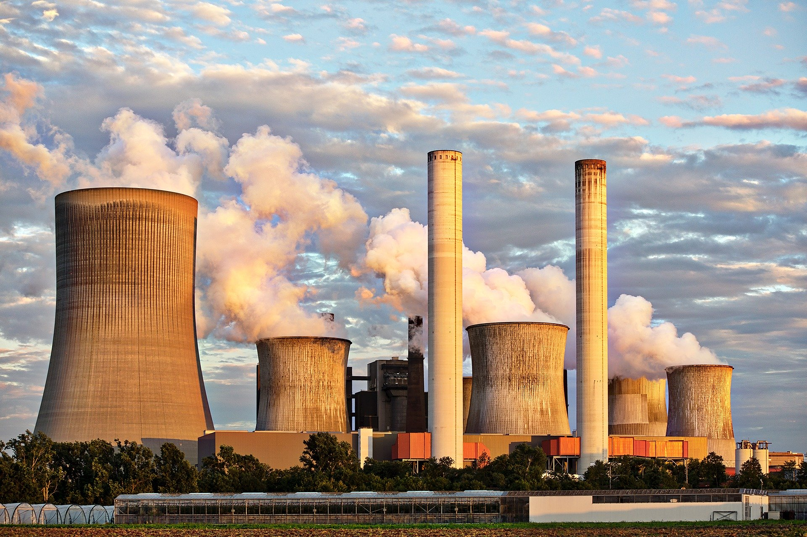
LOOK AT THE PICTURE AND DESCRIBE WHAT DO YOU SEE?

Slide 5

LET’S WATCH A VIDEO..!!!!
https://youtu.be/Tds3k97aAzo

Slide 6

SHARE YOUR VIEWS…
What do you understand by the term Air pollution?

Slide 7
QUICK SURVEY
List the things surrounded by you which may cause Air Pollution? https://jamboard.google.com/d/14jyYKctdLHl5dcIQRn6XASn_HfgTkXM8ArxrtMMn6ws/viewer?f=0

Slide 8

IT’S TIME TO REFLECT
Select one thing and tell why it is a cause of air pollution?

Slide 9
EXTENDED ACTIVITY….
Extending activity includes a poster in which the students will be given a particular area to make a poster on.

Slide 10
THANK YOU..!!

